Slide 1
Structures (struct)
A struct is a derived data type composed of members that are each fundamental or derived data types
A single struct would store the data for one object. An array of structs would store the data for several objects
reference a contiguous block of physical memory, usually delimited (sized) by word-length boundaries

Slide 2
Structures (struct)
The general syntax for a struct declaration
struct tag_name {
type member1;
type member2;
/* declare as many members as desired, but the entire structure size must be known to the compiler. */
};
typedef struct tag_name struct_alias;

Slide 3
Structures (struct)
Does Not Reserve Space
struct my_example
{
int label;
char letter;
char name[20];
} ;
Reserves Space
struct my_example
{
int label;
char letter;
char name[20];
} mystruct ;
/* The name "my_example" is called a structure tag */
Members (field)

Slide 4
Structures (struct)
/* Forward declare a type "point" to be a struct. */
typedef struct point point;
/* Define a type point to be a struct with integer members x, y */
typedef struct {
int x;
int y;
};
/* Define a variable p of type point, and initialize all its members inline! */
point p = {1,3};
/* Change the member x of p to have the value of 3 */
p.x = 3;

Slide 5
Pointer
Pointer is a programming language object, whose value refers to (or "points to") another value using its memory address.
A pointer references a location in memory, and obtaining the value stored at that location is known as dereferencing the pointer (*)
Asterisk(*) indirection operator is used along with pointer variable while Dereferencing the pointer variable
Asterisk * Operator is also called as value at operator (Gives Value stored at Particular address)

Slide 6
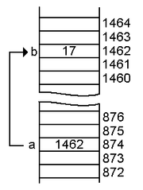
Pointer
Pointer a pointing variable b
int b = 17;
int *a = &b;
Note that b stores number, whereas a stores address of b in memory (1462)

Slide 7


Pointer
int *ip; /* the declaration of the poineter ip */
int i = 1; /* an integer */
int *ip; /* a pointer-to-int */
ip = &i; /* ip points to i */
printf("%d\n", *ip); /* prints i, which is 1 */
*ip = 5; /* sets i to 5 */
printf("%d\n", *ip); /* prints i, which is 5 now */
int j = 3; /* an integer */
ip = &j; /* ip points to j */
printf("%d\n", *ip); /* prints j, which is 3 */

Slide 8

Pointer
Pointers do not have to point to single variables. They can also point at the cells of an array. For example:
int *ip;
int a[10];
ip = &a[3];
ip pointing at the fourth cell of the array a (remember, arrays are 0-based, so a[0] is the first cell). The situation could be illustrated like this:

Slide 9
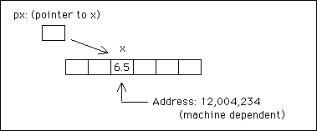
Pointer
char *pc;
double *px;
double x;
x = 6.5;
px = &x;
pc = (char*) px; /* ”cast” − converts one data type to another, px and pc both point to the same location in memory -- the address of x */
The () and [] have a higher priority than *

Slide 10
Pointer
char cff[5][5];
/* array of arrays of chars */
char *cfp[5];
/* array of pointers to chars */
char **cpp;
/* pointer to pointer to char ("double pointer") */
char (*cpf)[5];
/* pointer to array(s) of chars */
char *cpF();
/* function which returns a pointer to char(s) */
char (*CFp)();
/* pointer to a function which returns a char */
char (*cfpF*())[5];
/* function which returns pointers to an array of chars */
char (*cpFf[5])();
/* an array of pointers to
functions which return a char */

Slide 11
Pointers to struct
struct point {
int x;
int y;
};
struct point my_point = { 3, 7 };
/* To declare and define p as a pointer of type struct point,
and initialize it with the address of my_point. */
struct point *p = &my_point;
(*p).x = 8; /* To access the first member of the struct */
p->x = 8; /* Another way to access the first member of the struct */

Slide 12
Pointer
A special pointer type called the “void pointer” allows pointing to any (non-function) variable type
The void pointer, or void*, is supported in ANSI C as a generic pointer type
void pointer (handle) cannot be dereferenced directly: shall be cast
Date* pDate = (Date*) hDate;

Slide 13
Patterns
main.c
date.c
#include <stdio.h>
#include "date.h"
int main(int argc, char* agrv[])
{
DATE today = NULL;
out_date(today);
return 0;
}
#include <stdio.h>
#include "date.h"
struct date {
int month;
int day;
int year;
};
typedef struct date Date;
//typedef Date* Date_ptr;
void out_date(DATE hDate)
{
Date* pDate;
printf("%d", pDate->month);
}
date.h
typedef void* DATE;
void out_date(DATE hDate);

Slide 14
Patterns
int* p = NULL;
p = (int*)malloc(sizeof(int)); //(int*) casting
if (p == NULL) {
printf("Failed to allocate space for integer\n"); //error exit(1);
}
*p = 42;
free(p); //dangling pointer
p = NULL;
Opaque Object Pattern
Initialize the Object
Use the Object
Destruct the Object

Slide 15
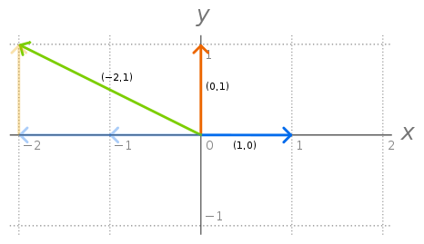
Vectors
Vectors are data structure containers.
Vectors are used for storing objects and collections of objects in an organized structure. Difference between and array and a vector is that the container size of a vector can be easily increased and decreased
Vectors can be thought of as dynamic arrays.
https://www.techopedia.com/definition/22817/vector-programming

